Slide 1
Education courses’ Beginning
Nurturing deep tech talents
for clean and sustainable
energy transition.

Slide 2
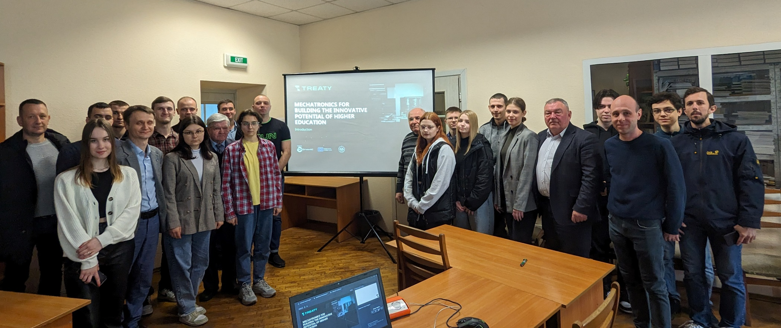
The beginning of courses "MECHATRONICS FOR BUILDING INNOVATIVE POTENTIAL OF HIGHER EDUCATION" AND "SYSTEMS OF ARTIFICIAL INTELLIGENCE FOR BUILDING THE INNOVATIVE POTENTIAL OF HIGHER EDUCATION"
On 1922 of February 2024, the Faculty of Construction and Design hosted the XI International Scientific and Technical Conference.
On 22nd April the education courses have started. In the opening ceremony, there were students, education staff, and administration representatives.
There were opening speeches from the dean of Design and Construction faculty, and education staff, who will deliver their knowledge and practical skills to the enrolled persons. In welcome words, they stressed the aims of the courses and provided brief information about topics to study, timetables, final exams, etc. The students presented at the meeting expressed their beliefs about the relevance of the topics and their interest in studying.
Learn more

Slide 3
The course ”MECHATRONICS FOR BUILDING INNOVATIVE POTENTIAL OF HIGHER EDUCATION”
The aim of the course ”Mechatronics for building innovative potential of higher education” is providing by students of theoretical knowledge and practical skills in the integration of mechanical, electronic and software components to create complex and functional mechatronic systems for the development of innovative potential higher education.
The course delivers to the attendants the necessary knowledge and skills for the design, production and operation of complex mechatronic systems in various fields, such as automation of agro-industrial production, robotics in the agricultural sector and many others.
Learn more

Slide 4
The course ”SYSTEMS OF ARTIFICIAL INTELLIGENCE FOR BUILDING THE INNOVATIVE POTENTIAL OF HIGHER EDUCATION”
The aim of the course ”Systems of artificial intelligence for building the innovative potential of higher education” is connected with providing students with theoretical knowledge and practical skills regarding the development and use of artificial intelligence systems in technical systems and strengthening the innovative potential of higher education.
The course students will obtain the knowledge and practical skills for the design, production and operation of artificial intelligence systems in various fields (agricultural production, automation, robotics, and many others).
Learn more

Slide 5
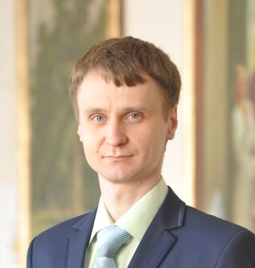
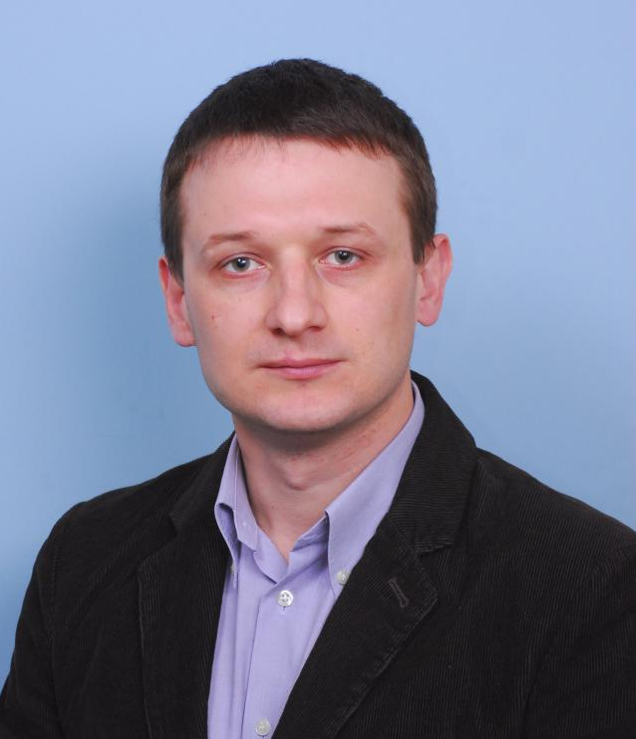
Instructor YURII ROMASEVYCH
Yuriy Romasevych is a highly skilled scholar, who developed many educational courses in Mechanical Engineering, Applied Mathematics, and Artificial Intelligence. His 16-year experience in educational and scientific activities has been awarded many state honors. He received scholarships for young scientists and carried out six scientific projects.
Learn more
instructor mykola korobko
Mykola Korobko is a scientific and pedagogical worker with 20-years experience. His pedagogical works are devoted to training courses in Mechanical Engineering. His activities in the educational and scientific fields has a strong practical orientation. Some of his handbooks are very popular for the training engineering courses.

Slide 6
Results of the courses
In total, more than 65 attendants will be trained in both courses. The structure of the courses and their content allow to reach the stated aims. This makes the basis for further improvement of technical means and technologies in important fields of production: green engineering, production digitalization, smart systems development, etc.
Learn more
treaty-project.eu

