Slide 1
GENETIC DISORDERS AND HEREDITARY DISEASES OF PUGS
Smulska A.A.
Demchenko A.E.

Slide 2
Dogs of the pug breed are funny, characterized by a light character and poise. The owner should know that they may be predisposed to a number of diseases. Twice a year, it is recommended to perform a pug examination and standard diagnostic measures: this will allow you to detect dog diseases at an early stage, when they are still easy to eliminate.

Slide 3
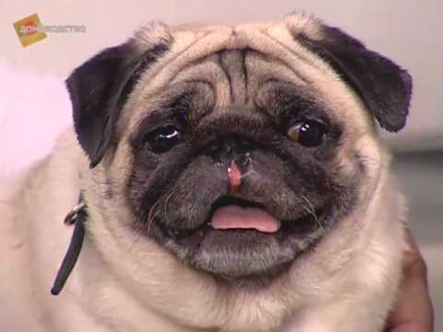
What can a pug hurt?
Pug diseases are quite versatile. They can affect the ears, eyes, skin and coat, respiratory organs, heart, etc. Often these dogs suffer from allergies of various origins.
In connection with the peculiarities of the anatomy, pugs are prone to problems with excess weight, the digestive tract and the musculoskeletal system. Colds are also not alien to them.

Slide 4
Symptoms of diseases in pugs:
increased drowsiness;
lethargy;
vomiting
the dog often scratches his eyes;
increase in body temperature;
increased aggressiveness and irritability;
fecal change;
discharge from the nose, eyes, or ears.

Slide 5
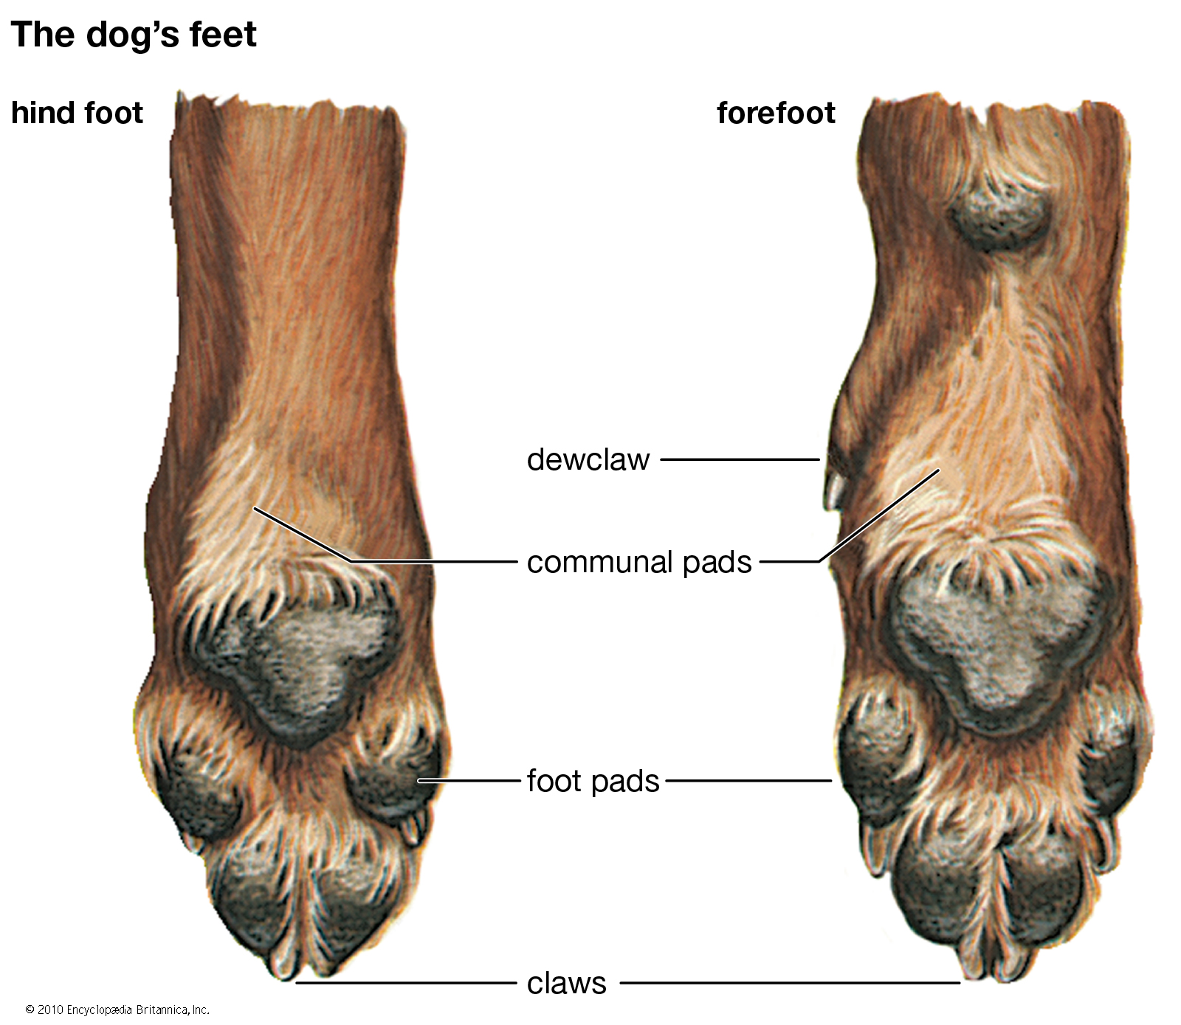
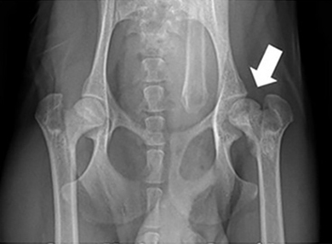
Genetic pathology
A)
A) Pug breed genetic diseases are caused by the peculiarities of paw structure, strong physique and the presence of a short muzzle while maintaining a long palate. Thus, the physiology of dogs is a prerequisite for the development of a number of pathologies that, in the absence of timely treatment (often surgical), can lead to irreversible consequences.
B) Aseptic necrosis of the femoral head is a pathology accompanied by a violation of the blood supply to the femur, most often of both hind legs. As a result, the dog becomes inactive and uncomfortable with any touch of the affected paws. If at this stage you do not intervene during the pathological process, gradually the limbs begin to fail, and the muscles atrophy and dry out. To restore the animal's mobility will help a timely operation.
B)

Slide 6
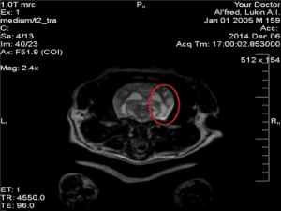
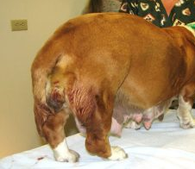
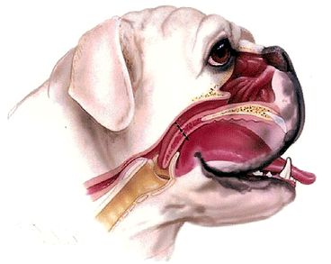
A)
A) Necrotizing meningoencephalitis is a common genetic disease in small breed dogs. Typically, inflammation of the membranes of the brain is typical for him, which leads to seizures, paralysis, weakness of the paws. Treatment is carried out conservatively.
B) Uterine inflammation in female dog is a pathology common among pugs of middle and older age. It is accompanied by frequent urge to urinate amid intense thirst and general weakness. In some cases, purulent discharge is noted. At the initial stages of the development of inflammation, a conservative treatment is possible, but in advanced cases, it is often necessary to surgically remove the uterus and appendages.
C) Brachycephalic syndrome is the most common genetically caused pug disease, provoked by the features of the structure of the muzzle. Her typical cough and grunts are typical. Pugs after a long walk, high physical activity, or during the heat may have difficulty breathing and begin to grunt. An animal with a brachycephalic syndrome snores from birth and this is normal for him. But when snoring occurs in adulthood, it is worth suspecting other diseases.
B)
C)

Slide 7
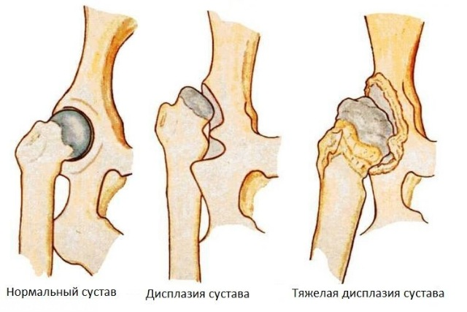
Magnetic resonance image findings in pug dogs with thoracolumbar myelopathy and concurrent caudal articular process dysplasia
Background
A retrospective case series study was undertaken to describe the magnetic resonance imaging (MRI) findings in Pug dogs with thoracolumbar myelopathy and concurrent caudal articular process (CAP) dysplasia. Electronic clinical records were searched for Pug dogs who underwent MRI for the investigation of a T3-L3 spinal cord segment disease with subsequent confirmation of CAP dysplasia with computed tomography between January 2013 and June 2017. Clinical parameters age, gender, neuter status, body weight, urinary or faecal incontinence, severity and duration of clinical signs were recorded. MRI abnormalities were described. Univariable non-parametric tests investigated the association between the clinical parameters and evidence of extra- or intra-dural spinal cord compression on MRI.

Slide 8
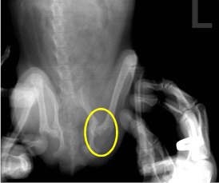
Results
18 Pug dogs were included. The median age was 106 months with median duration of clinical signs 5 months. All presented with variable severity of spastic paraparesis and ataxia; 50% suffered urinary/faecal incontinence. In all cases, MRI revealed a focal increase in T2-weighted signal intensity within the spinal cord at an intervertebral level where bilateral CAP dysplasia was present; this was bilateral aplasia in all but one case, which had one aplastic and one severely hypoplastic CAP. MRI lesions were associated with spinal cord compression in all but one case; intervertebral disc protrusion resulted in extra-dural compression in 10 (56%) cases; intra-dural compression was associated with a suspected arachnoid diverticulum in 4 (22%) cases and suspected pia-arachnoid fibrosis in 3 cases (17%). There was no association between clinical parameters and a diagnosis of intra-dural vs extra-dural compression. CAP dysplasia occurred at multiple levels in the T10–13 region with bilateral aplasia at T11–12 most often associated with corresponding spinal cord lesions on MRI.

Slide 9
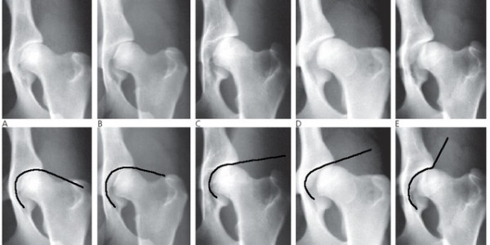
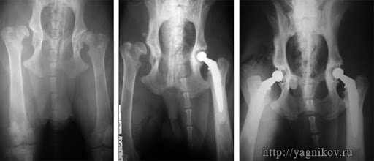
Conclusions
All Pugs dogs in this study were presented for chronic progressive ambulatory paraparesis; incontinence was commonly reported. Although intervertebral disc disease was the most common radiologic diagnosis, intra-dural compression associated with arachnoid diverticulae/fibrosis was also common. Bilateral CAP aplasia was present in all but one Pug dog at the level of MRI detectable spinal cord lesions. A causal relationship between CAP dysplasia and causes of thoracolumbar myelopathy is speculated but is not confirmed by this study.
Source: DOI: 10.1186/s12917-019-1866-0

Slide 10
Magnetic resonance imaging of the thoracolumbar spine of case no. 6, displaying extra-dural spinal cord compression associated with T11–12 disc protrusion and concurrent bilateral T11 caudal articular process aplasia. From left to right; T2-weighted mid sagittal of thoracolumbar spine, T2-weighted transverse at the affected level T11–12 (transverse level marked with a dashed line), three-dimensional reconstruction of thoracolumbar junction on CT (T11–12 marked with dashed line; the normal articular processes of T12 are highlighted with an arrow head). There is a marked focal increase in T2-weighted signal within the spinal cord despite only mild ventral extra-dural spinal cord compression (arrowed on transverse image)

Slide 11
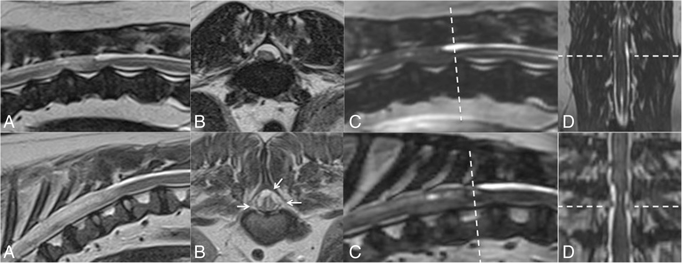
Magnetic resonance imaging of the thoracolumbar spine of case no. 8 (top row) and 14 (bottom row) who display intra-dural spinal cord compression. From left to right; a = T2-weighted sagittal MRI, b = T2-weighted transverse MRI, c = CISS sequence reconstructed in sagittal plane, d = CISS sequence reconstructed in dorsal plane. In case 8, intra-dural spinal cord compression appears to be associated with an expansion of the dorsal arachnoid space, consistent with spinal arachnoid diverticula. CISS imaging highlights this CSF accumulation without apparent attachment of the dura to the pia (dashed line). In case 14, in a transverse plane (lower row image b) the spinal cord appears to develop a ‘stellate’ appearance with multiple hypo-intense bands that cross the arachnoid space (highlighted with short arrows on image b). At the corresponding level on CISS imaging (lower row, images c and d, dashed line) the hypo-intense bands appear lateral to the compressed spinal cord (level marked with dashed line) with an appearance reminiscent of the original description of ‘constrictive myelopathy’.

Slide 12
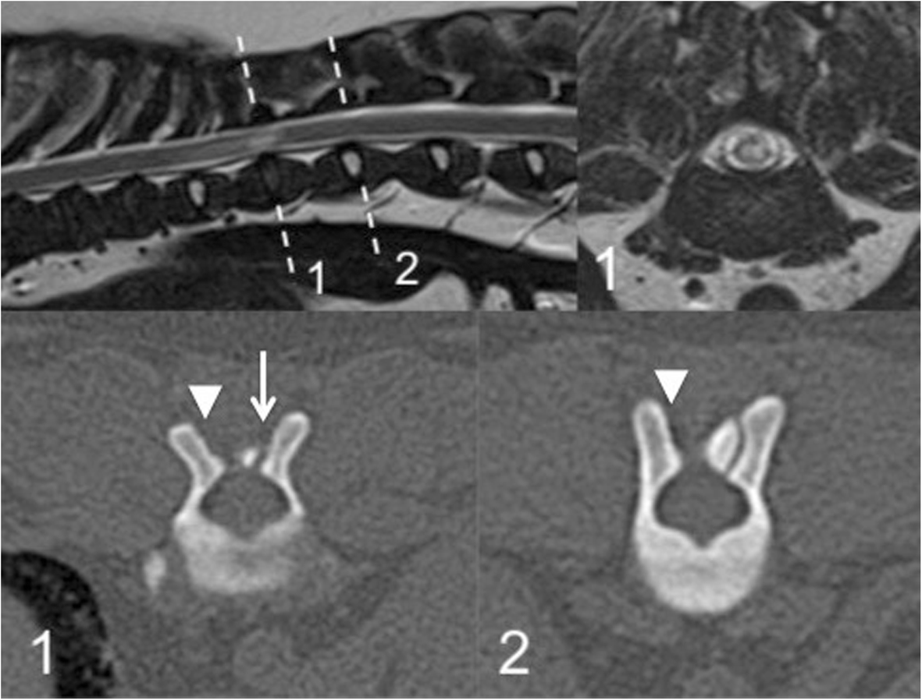
Magnetic resonance imaging and computed tomography of the thoracolumbar spine of case no. 13, which does not clearly display spinal cord compression. Top row left to right; sagittal T2-weighted image of the thoracolumbar spine, transverse T2-weighted image at the level of the spinal cord lesion at T11–12 (corresponding to dashed line labelled 1). Bottom row left to right; transverse computed tomography slice at affected level T11–12 (corresponding to dashed line labelled 1) displaying concurrent bilateral caudal articular process dysplasia (left-sided hypoplasia, arrowed, right-sided aplasia, arrow-head), transverse computed tomography slice at unaffected level T12–13 (corresponding to dashed line labelled 2) displaying unilateral (right-sided; arrow-head) caudal articular process aplasia

Slide 13
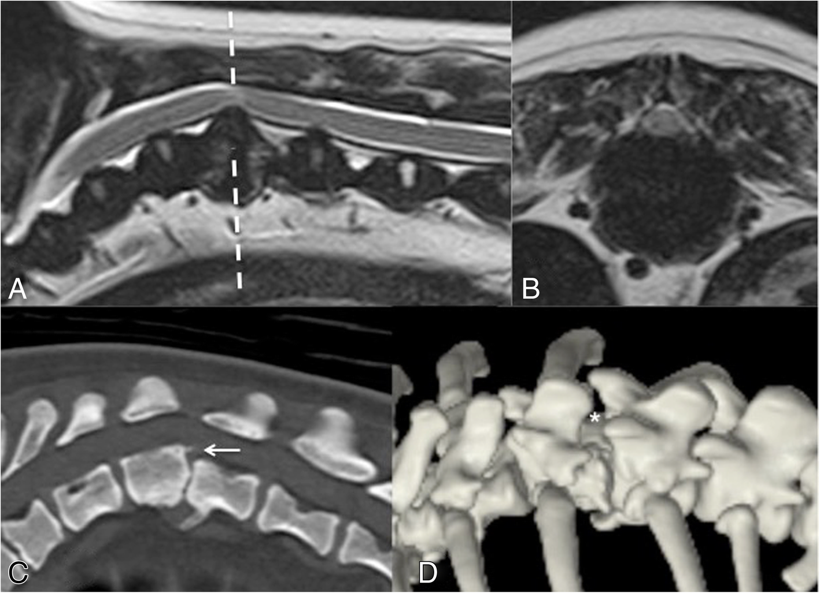
Magnetic resonance imaging and computed tomography of the thoracolumbar spine of case no. 18. a = T2-weighted sagittal MRI, b = T2-weighted transverse MRI at affected level T11–12 (corresponding to dashed line from image a), c = sagittal reconstruction of CT centred on T11–12, d = Three-dimensional reconstruction of CT viewed from a dorsolateral aspect. There is extra-dural spinal cord compression due to T11–12 intervertebral disc protrusion (images a and b). The vertebral column adopts a kyphotic appearance with marked narrowing of the T11–12 intervertebral disc space, with apposing vertebral end-plate sclerosis, ventral spondylosis deformans and slight retrolisthesis (image c; arrowed). There is bilateral aplasia of the caudal articular processes of T11 with an increase in the distance between the dorsal laminae of T11 and T12 (image d; asterisk)

Slide 14
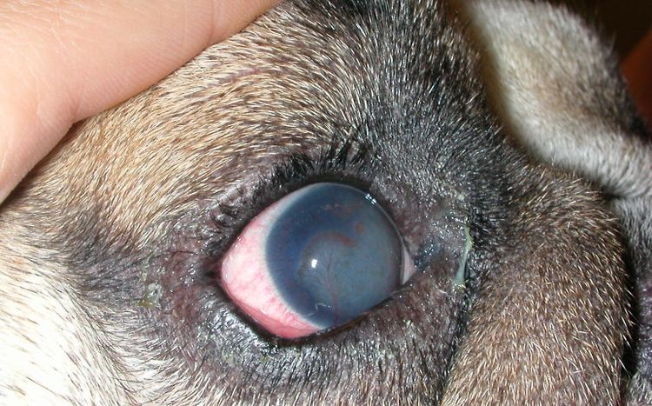
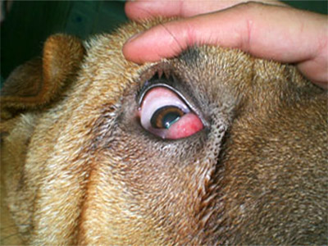
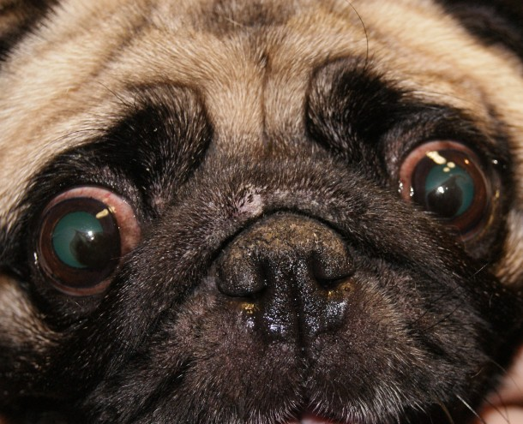
Eye problems
A)
Among what a pug can hurt, the eyes play a paramount role. Due to the structural features, the eyeball may fall out of the eye socket, which requires urgent help from a veterinarian.
Also often observed:
A) Dry eye syndrome (keratoconjunctivitis). It develops due to insufficient production of tear fluid and is accompanied by redness and inflammation of the eyes. Sometimes this can be complicated by the addition of a secondary infection.
B) Entropion is an eversion of the edge of the century inward. This leads to constant irritation of the mucous membrane of the eye with eyelashes, which provokes an inflammatory process. The disease is treated surgically.
C) Keratitis is an inflammation of the cornea, which is accompanied by redness of the eyeball and clouding of the cornea.
B)
C)

Slide 15
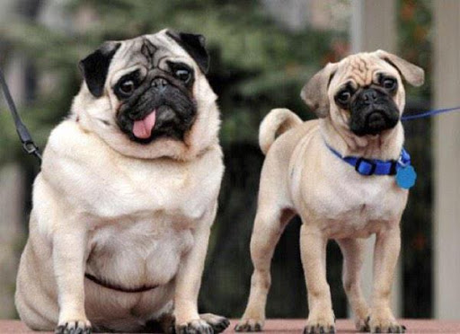
Obesity
Being overweight is a problem due to improper grooming of the pug. When its signs appear, the dog necessarily needs a diet. Otherwise, the dog may manifest persistent constipation, colitis, the development of heart disease and serious breathing problems.

Slide 16
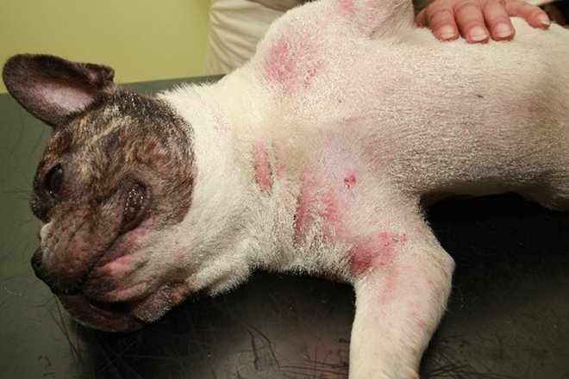
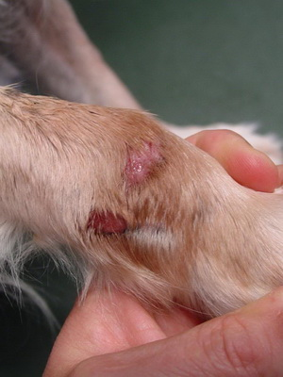
Skin diseases
A)
The pug’s health problems often affect the condition of the coat, it becomes dull and may fall out.
Very often this is an allergy to certain foods, dry food, plant pollen, household chemicals, collar material, bedding, etc.
Pugs tend to comb the place of an allergic reaction to blood.
There are other skin pathologies:
A) juvenile demacosis - a disease caused by a specific tick and accompanied by baldness, reddening of the skin, itching and the formation of red pimples with a dark spot in the middle in the genital area and abdomen;
B) dermatitis - a disease provoked by an allergic reaction to something and accompanied by the appearance of itching and foci of inflammation on the muzzle, between the fingers, in the anus and under the paws.
B)

Slide 17
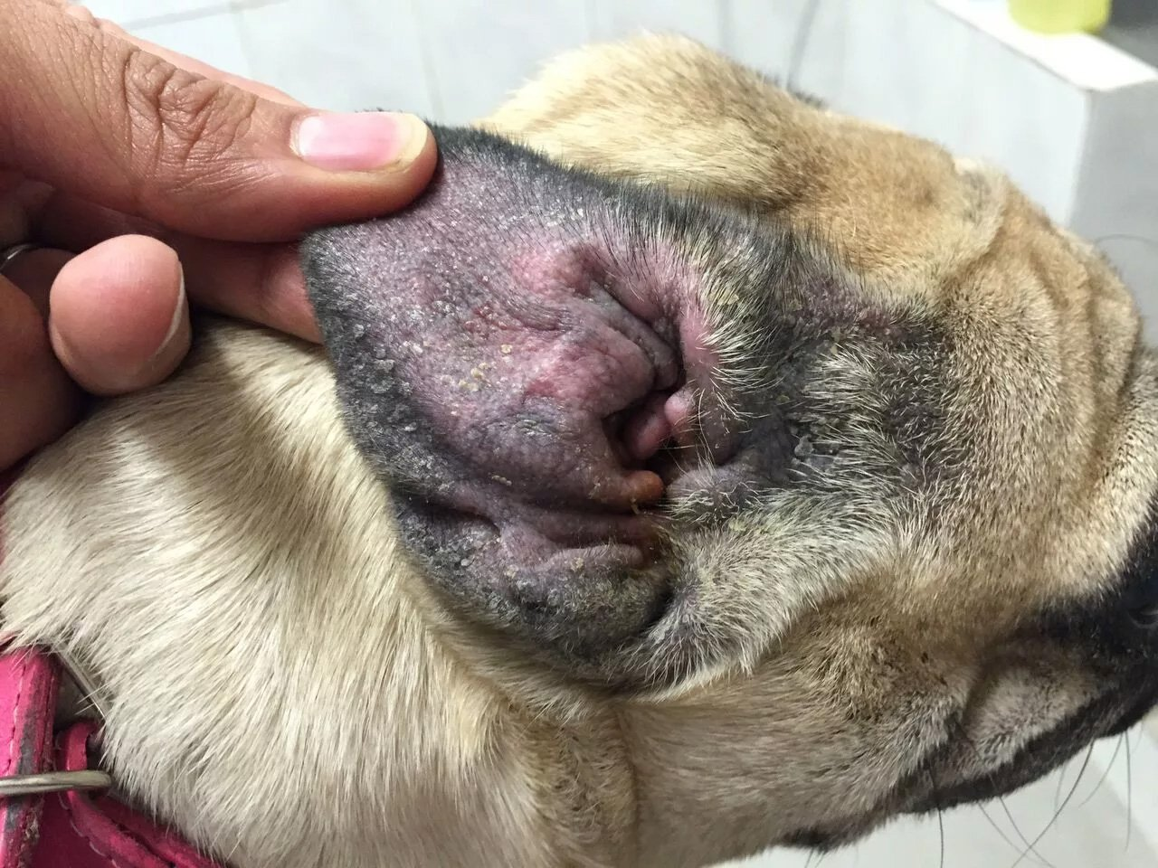
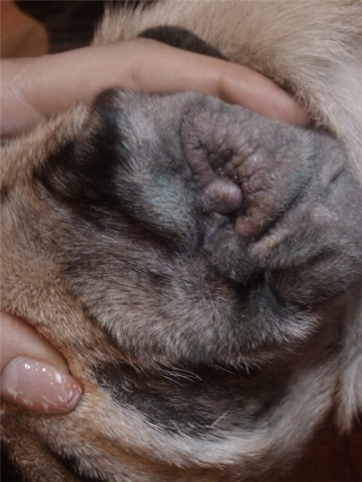
Ear pathology
Pugs no less than dogs of other breeds are subject to otitis media. Ear infection can occur:
redness of the ear canal;
lethargy;
itchy ears;
fever;
the appearance of discharge (in severe cases).
Treatment is carried out using special antibacterial drops.
A)
B)
A), B) — otitis

Slide 18
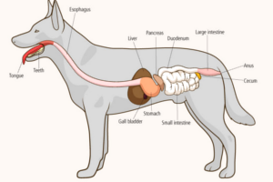
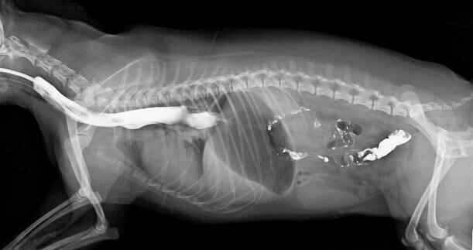
Gastrointestinal diseases
A)
A) Pugs are prone to developing diseases of the gastrointestinal tract, especially gastritis and ulcers. Their symptoms are diarrhea and vomiting, sometimes with blood.
To normalize the condition of the dog, it is necessary to strictly observe a sparing diet, ensure a plentiful drink, give special preparations recommended by the veterinarian and never treat the dog with food from the owner's table.
A)

Slide 19
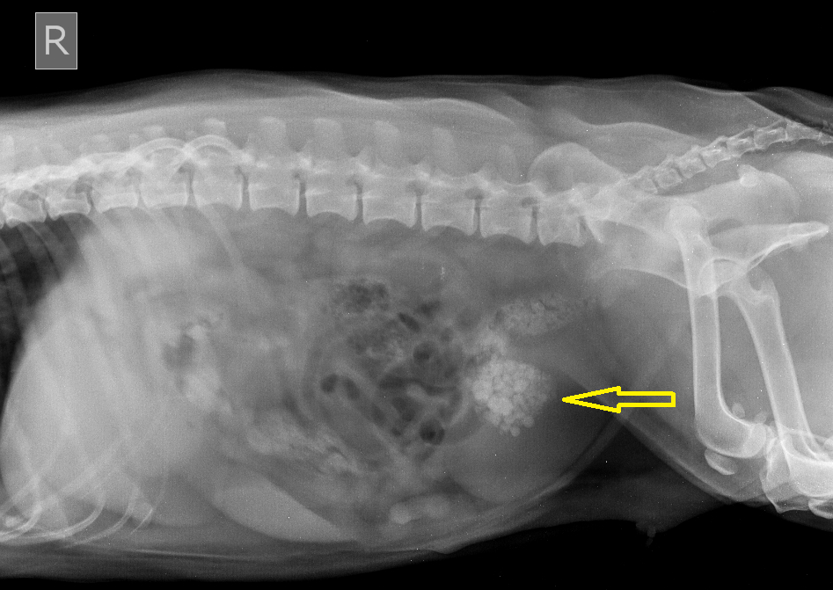
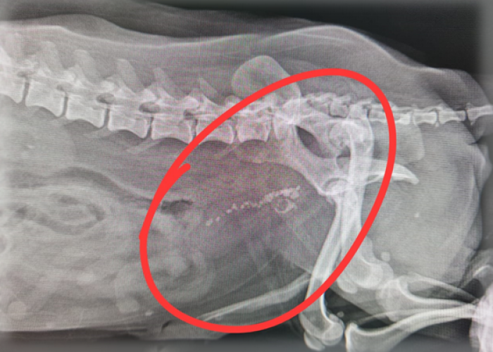
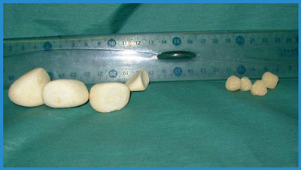
Urolithiasis disease
Urolithiasis is a dangerous pathology in which stones of different sizes form in the kidneys. Under the influence of various factors, they can begin to move along the urinary tract, causing terrible pain to the dog. Symptoms also indicate the development of the disease:
the presence of blood or pus in the urine;
frequent urination, and not always the dog can endure a walk;
frequent licking of the inguinal region;
weakness.
Treatment can be carried out conservatively or surgically.

Slide 20
Prevention and vaccination
The main prevention of disease is proper care and carefully thought out nutrition. Pugs are often allergic to chicken, eggs, fish, any sausage and dairy products. It is equally important to get vaccinations in a timely manner, according to the vaccination schedule and put on a warm jumpsuit for the dog in the cold season.
For puppies, it’s important to choose a suitable collar, as too tight or loose can cause spinal curvature and disability. Do not give pugs strong physical exertion, especially in the heat, due to weakness of the heart.
To prevent the development of skin diseases, it is necessary to bathe the dog every 2 weeks with a quality shampoo and regularly wipe every fold of skin regularly.

Slide 21
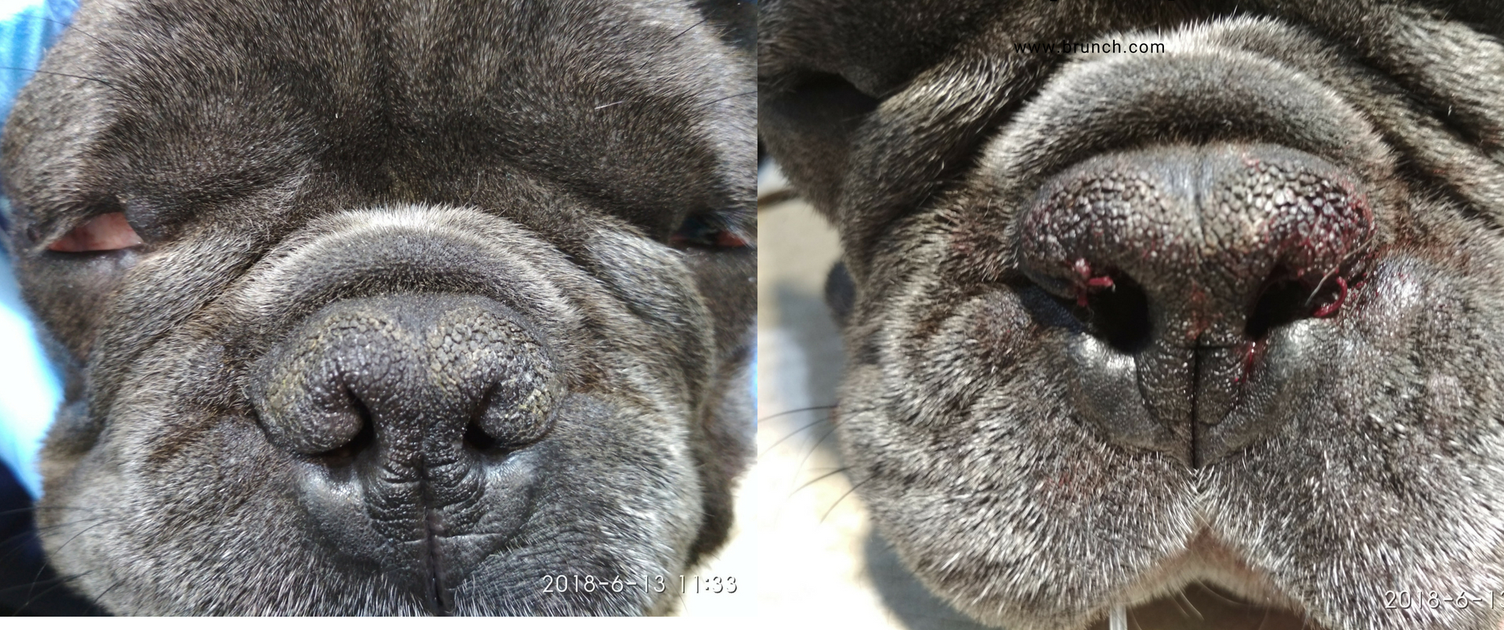
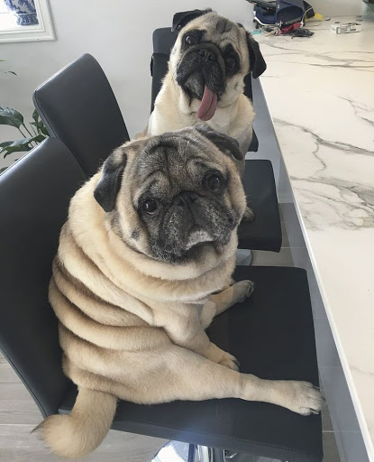
Interview with veterinarians (prepared by 1 year students of 8 group)
A)
Vet Doctors of Khartsyzsk, Volegonov E.V. and Maryna Oleksiivna
What congenital problems are most common in pugs?
A) They are brachycephalic, ie flattened muzzle. Problems with the nasal passages, with the nasopharynx. Because of this, they constantly snore, under anesthesia, the soft palate begins to sink and they begin to suffocate.
In general, pugs are brought to the clinic quite often
Do the pugs often have allergies?
B) Quite often, the body's tendency to do so, especially to sweet and fatty
B)

Slide 22
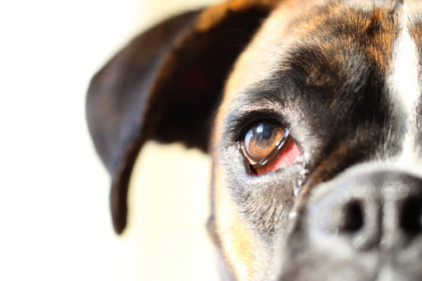
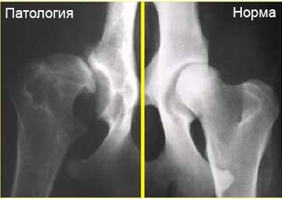
A)
Is it possible to somehow alleviate the condition with brachycephalic syndrome?
There is nothing you can do about it, you can't fix the congenital
Are there any eye diseases that are more common than in other dogs?
A) Conjunctivitis. Due to the fact that their eyes are wide open, the eyelids do not close well, the infection occurs quite often. In addition, they have a fold of skin over the nose and almost always there, it must be constantly cleaned and treated with special powders (also constantly do it)
Do their eyes fall out?
Most often not, these are rare cases. This problem is typical of the Pekingese
What about hip dysplasia in pugs?
B) Not often, this is more of a problem for large dogs, or too dwarf. In general, this problem in all dogs is related to breeders and other people. Connect animals with a mild degree of dysplasia, and from this come puppies with serious problems
I would also like to say that most animal health problems can be solved with a proper and balanced diet
B)

Slide 23
photo resources
1.)https://www.wayfair.com/outdoor/pdx/hi-line-gift-ltd-hanging-pug-puppy-statue-hiln1897.html
2.)https://www.pinterest.com/pin/475270566903222569/
3.)https://unsplash.com/photos/7u8m3tWqUKM
4.)https://provsehsobak.ru/malenkie-porody-sobak/mops/lishnij-ves-u-mopsa-chto-delat.html
5.)https://images.app.goo.gl/Eusr4JTyVJfS2SGG8
6.)https://aminoapps.com/c/grustnyemops/page/blog/viktorina-po-etomu-amino/10j6_Dqh6uW3p1M6Y1VojlqX5RZNZM7en
7.)https://www.britannica.com/animal/dog/Domestication
8.)https://infovet.ru/lib/ortopediya/bolezn-pertesa-ili-osteokhondropatiya-golovki-bedrennoy-kosti/
9.)https://med-vet.ru/stati/nevrologiya/meningoencefalit-u-sobak/
10.)https://vetpraktika.ru/article/piometra-u-sobak-i-koshek-opisanie-vospaleniya-matki-priznaki-piometry
11.)https://aybolit.od.ua/stati/braxiczefalicheskij-sindrom.html
12.)http://olvaldenis.mybb.ru/viewtopic.php?id=177
13.)https://www.eduherald.ru/ru/article/view?id=16273
14.)https://tvoidrug.com/health/bolezni/displaziya.html 15.)http://yagnikov.ru/directions/orthopedy/97-dysplasia
16.)https://bmcvetres.biomedcentral.com/articles/10.1186/s12917-019-1866-0/figures/1
17.)https://bmcvetres.biomedcentral.com/articles/10.1186/s12917-019-1866-0/figures/1
18.)https://bmcvetres.biomedcentral.com/articles/10.1186/s12917-019-1866-0/figures/2
19. )https://bmcvetres.biomedcentral.com/articles/10.1186/s12917-019-1866-0/figures/3
20.)https://bmcvetres.biomedcentral.com/articles/10.1186/s12917-019-1866-0/figures/4
21.)http://okovet.ru/vivorot-zavorot-vek.php
22.)https://images.app.goo.gl/vxjDZ6QcJ58q3BoMA
23.)https://poroda-mops.ru/ozhirenie-u-mopsov/
24.)https://zoo-bazar.com/i/kormlenie-mopsa/
25.)https://www.mini-dogs.ru/articles-health/ozhirenie-u-miniatyurnyh-sobak.html
26.)https://kot-pes.com/demodekoz-u-sobak-lechenie/
27.)https://www.1001dog.com/polezno-znat/vidy-dermatitov-u-sobak-kak-vyglyadyat-i-chem-lechit.html
28.)https://images.app.goo.gl/yBrZMn9A1bPxTygT6
29.)http://www.bkvet.ru/forum/showthread.php?t=6165
30.)https://images.app.goo.gl/RMJcAgjTPY2zMf7KA

Slide 24
photo resources
31.)https://www.vetmag.ru/advice/sobaki-bolezni/problemy-s-zhkt-u-sobaki/
32.)https://vet-centre.by/services/nephrology/diagnostika-i-lechenie-mkb/
33.)http://invetbio.spb.ru/school/lecture6.htm
34.)https://vodoleyvet.ru/articles/mochekamennaya-bolezn-u-sobak-lechenie-i-simptomyi.html
35.)https://images.app.goo.gl/5JdwjrV5WUrGV6vg8
Articles:
https://zooset.ru/articlesbreed/bolezni_mopsov
https://pubmed.ncbi.nlm.nih.gov/31151444/?from_term=pug&from_sort=date&from_page=2&from_pos=7
https://bmcvetres.biomedcentral.com/articles/10.1186/s12917-019-1866-0
O’Neill DG, Darwent EC, Church DB, Brodbelt DC. Demography and health of pugs under primary veterinary care in England. Canine Geneti Epidmiol. 2016;3:5. https://doi.org/10.1186/s40575-016-0035-z.
36.)http://vet-panda.dp.ua/o-sobakah/kto-takie-brahitsefaly-anatomicheskie.html
37.)https://images.app.goo.gl/M2kK8DjvxhQsfWQc8
38.)https://images.app.goo.gl/9h1MznJDyVoemeUt8
39.)https://www.biocontrol.ru/specialistam/xirurgiya/diagnostika-i-lechenie-displazii-tazobedrennyx-sustavov-tbs-u-sobak.html
40.)https://www.pinterest.com/pin/551620654339076071/

Slide 25
THANK YOU FOR THE ATTENTION!

