Slide 1
Сell biophysics
Форма проведення засідання на прикладі студентки факультету ВеМ
Яценко Анастасія
1 курс 8 група

Slide 2
What the cell biophysics is?
Cell biophysics studies the physical bases of cell functioning, structure and basic functions of biological membranes (surface plasma membrane and membranes of intracellular organoids) - permeability, catalytic activity, electrical and chemical excitability, energy processes of the cell, its electrical properties, their mechanical properties , nerve impulse generation and propagation, processes of reception and energy conversion, most of which are carried out on biomembranes.

Slide 3
The cell

Slide 4
Membrane biophysics
Membrane biophysics is the most important section of cell biophysics, which is of great importance for biology and medicine. Many life processes take place on biological membranes. The disorders of the membrane processes are the cause of many pathologies

Slide 5
Cell membrane

Slide 6
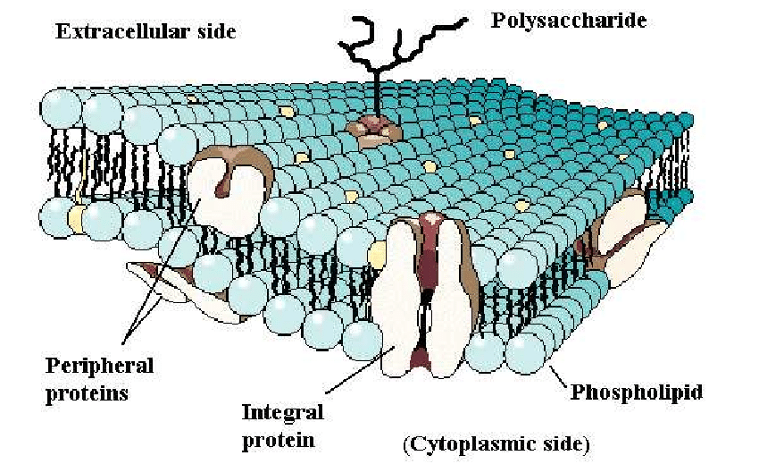

Slide 7
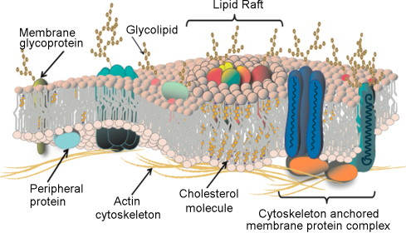

Slide 8
Membrane biophysics
Membrane receptors provide the perception of light, chemical mediators, mechanical stimuli, temperature, electric field, etc. The smaller the size of cells, the greater their specific surface area is and the more important role membrane plays in the cell activity

Slide 9
The main functions of cell membranes :
- barrier
- matrix
- mechanical
- energy
- receptor

Slide 11
Cell structure and bilipid layer function
The cell membrane is a double layer of phospholipids located between two thin layers of fibrillar protein molecules, which in turn are surrounded by molecules of globular proteins.
Hydrophobic and hydrophilic interaction forces play an important role in maintaining the membrane structure. Due to the hydrophobic forces of interaction, a lipid bilayer is formed, as well as non-polar regions attached to the lipid layer in the protein.

Slide 12
Cell structure and bilipid layer function
Common to all membranes are barrier functions for ions and molecules matrices for protein ensembles , provided mainly by
lipid bilayer. However, the set of proteins is individual for every
type of membranes that allow the latter to participate in the performance various functions in cells and cell structures.
The presence of a bilipid layer in cells is responsible for selectivity penetration through this barrier of certain substances that creates conditions for occurrence on the membrane of osmotic pressure

Slide 13
Biomembrane research
X-ray analysis method - based on the diffraction phenomenon. Diffraction is observed when there are obstacles in the path of the rays, comparable in size to the wavelength of the rays. The method of x-ray analysis is that a parallel beam of x-rays is directed to the object under study. A photographic film is placed behind the object, on which the resulting diffraction image is recorded.

Slide 14
Thanks for attention!

