Slide 1
Guidelines for participants to join the online conference

Slide 2
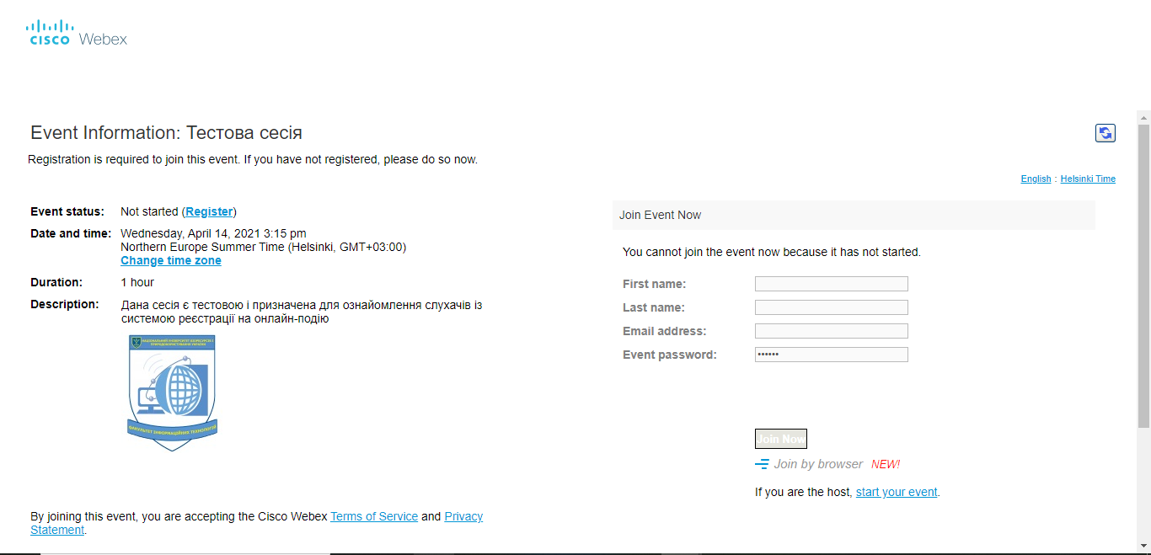
Following the link you enter the page of the conference. On the page, first of all, you have to register yourself. For that press the button Register

Slide 3
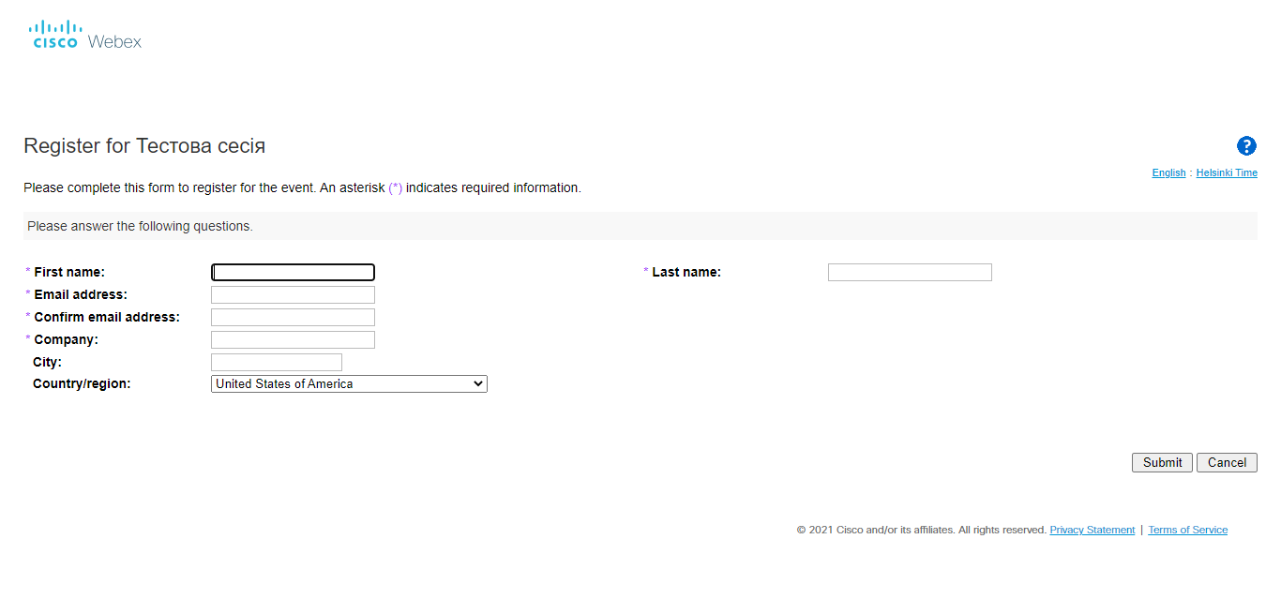
Please, fill requested information in the registration form

Slide 4
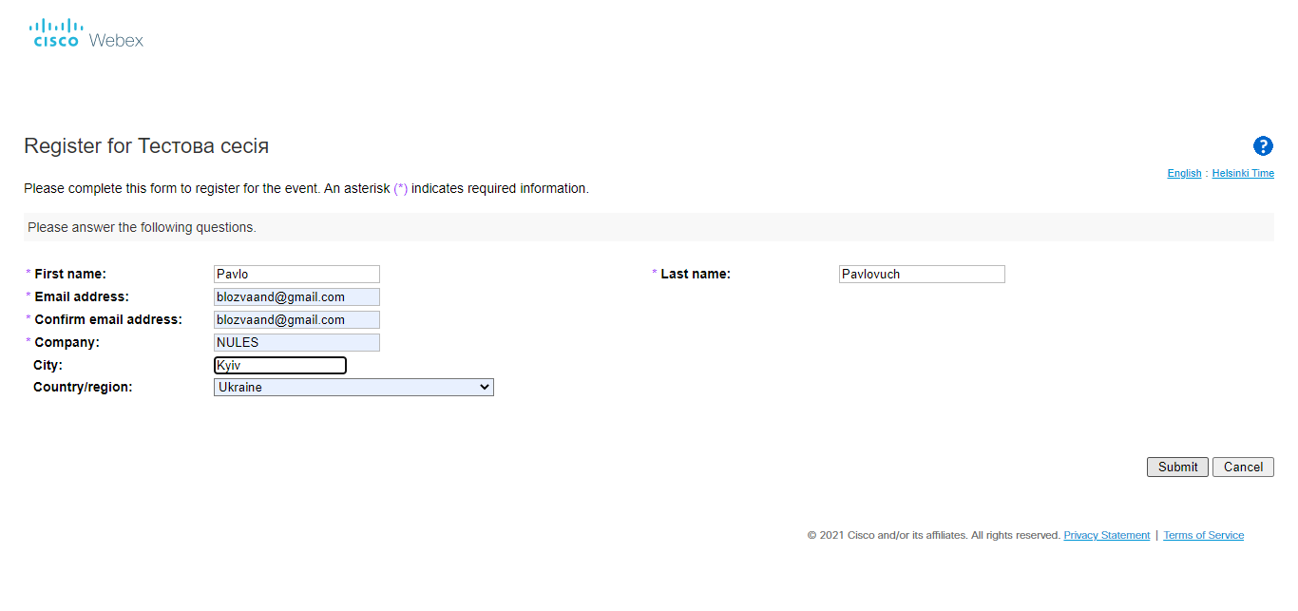
After press the button Submit

Slide 5
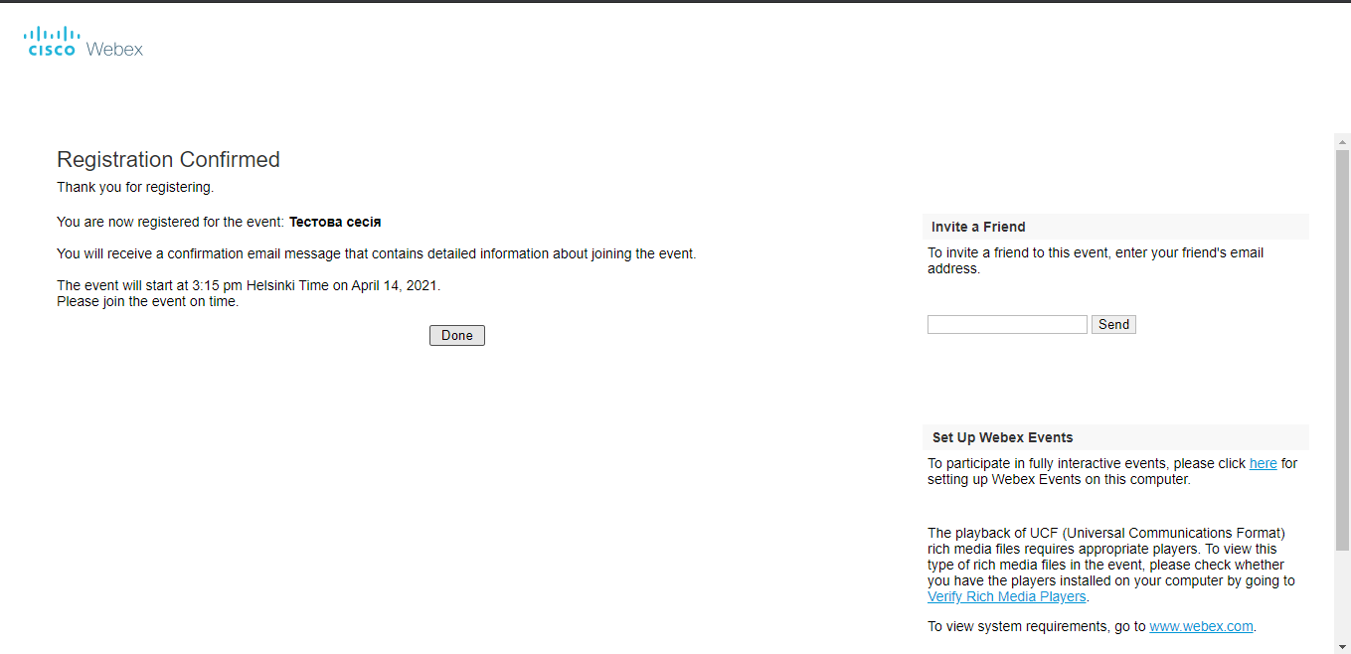
Futher, you need to confirm your registration by clicking the button Done

Slide 6
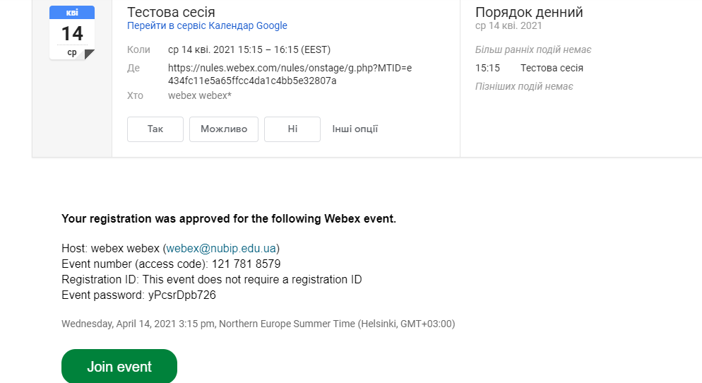
After registering for the conference, check your mail. You will receive an email inviting you to join the session. You can click the Join Event to join the session. IMPORTANT to copy the password that came in the letter to log in.

Slide 7
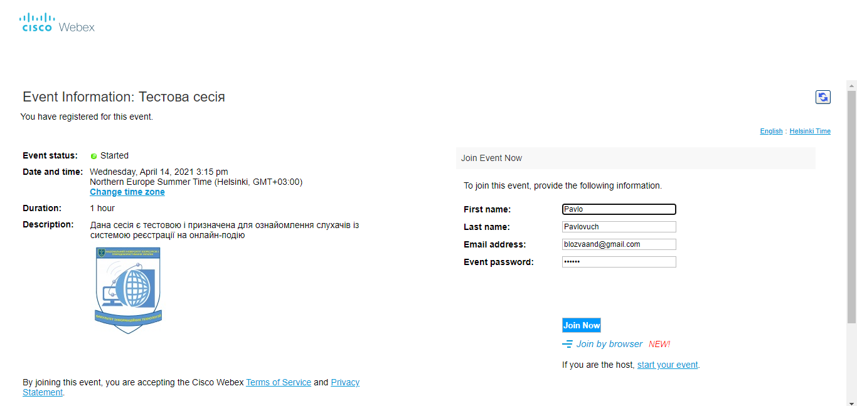
On the day of the session itself, pay attention to the status of the event. Event status must be active. Next, to connect to the event, enter your details that you entered during registration. And be sure to enter the password that came in the mail.

Slide 8
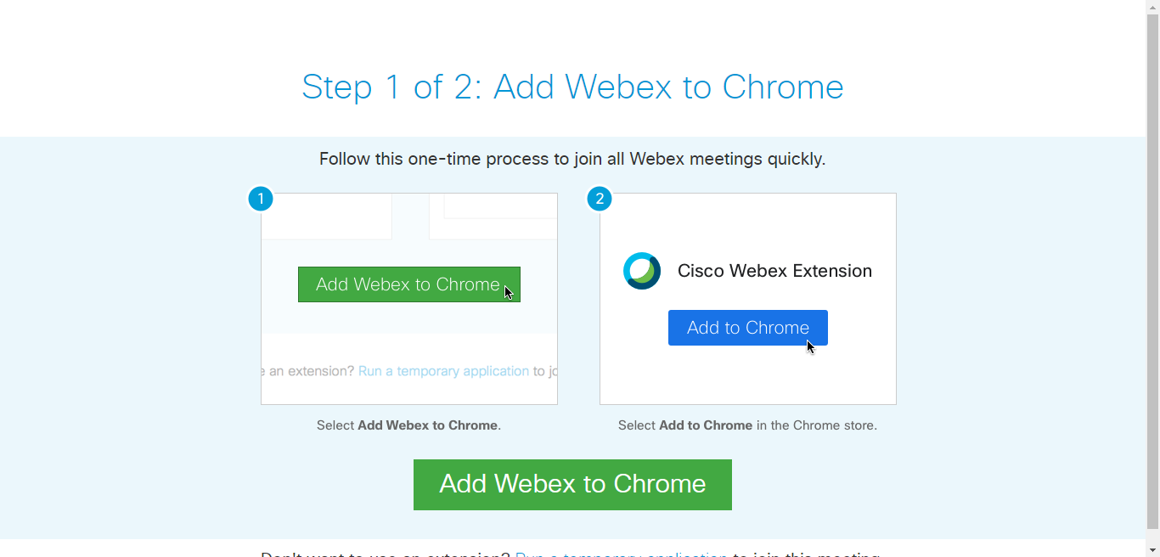
If you are visiting this event for the first time, you will be prompted to install the application on your browser. In this case, agree to its installation. APPENDIX IS COMPLETELY SAFE AND DOES NOT USE CONFIDENTIAL INFORMATION

Slide 9
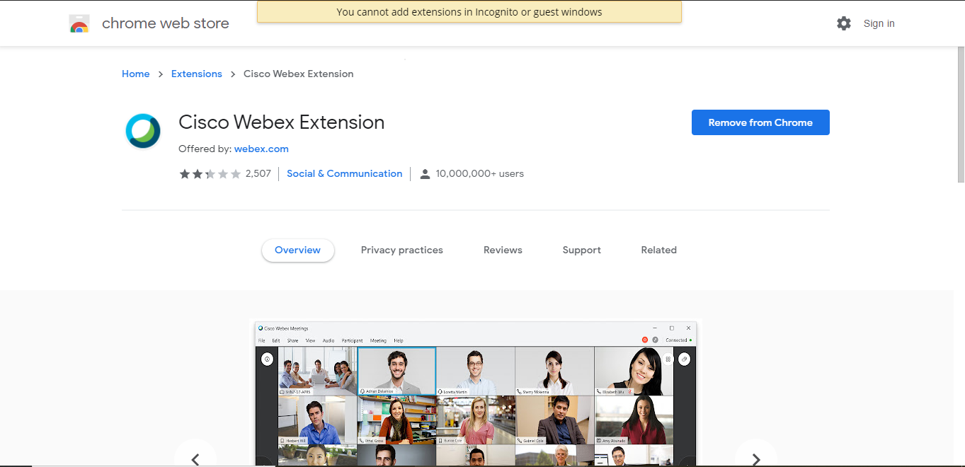
Add the application to your browser and then you can go to the online event

